Slide 1
Mindtree Kalinga – An Overview

Slide 2
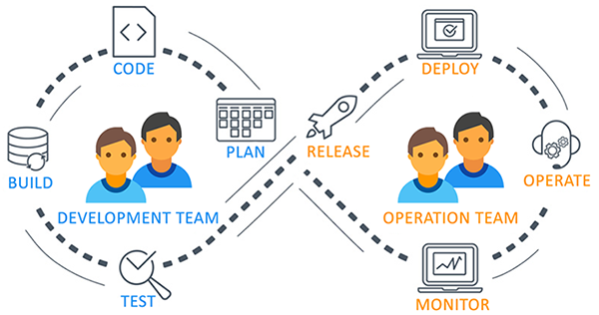
What is DevOps?
A software development approach which involves Continuous development, continuous testing, Continuous integration, Continuous deployment and continuous monitoring of the software throughout its development lifecycle.

Slide 3
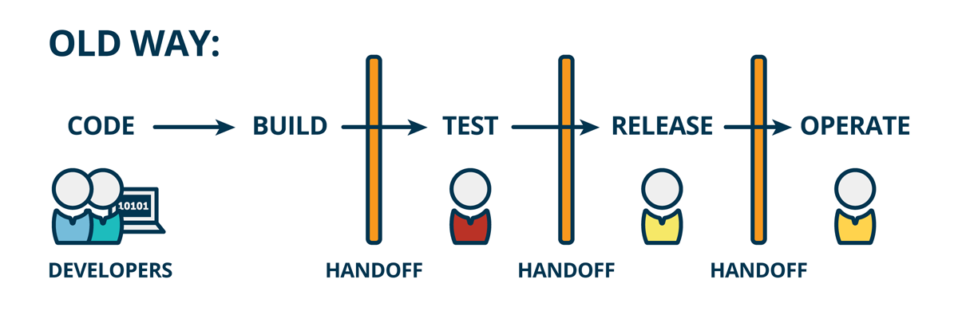
Before DevOps came into existence

Slide 4
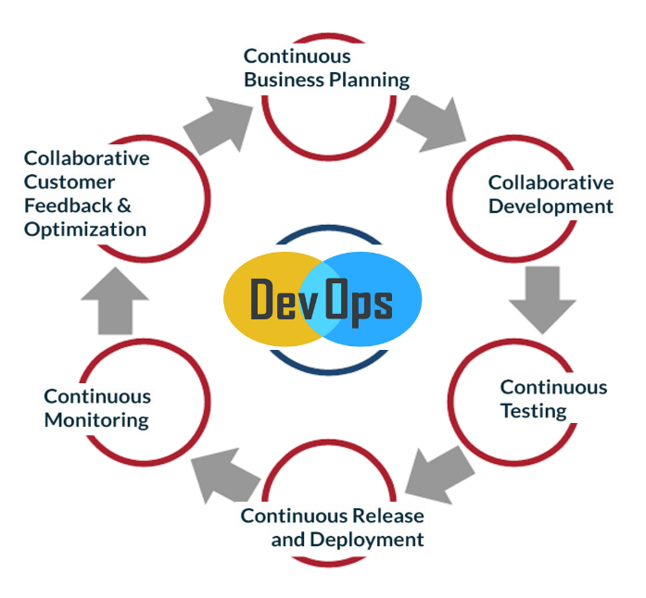
Why DevOps?
Shorter Development Cycles, Faster Innovation
Reduce Implementation Failure, Reflections and Recovery Time
Better Communication and Cooperation
Greater Competencies
Reduce Costs and IT Staff

Slide 5
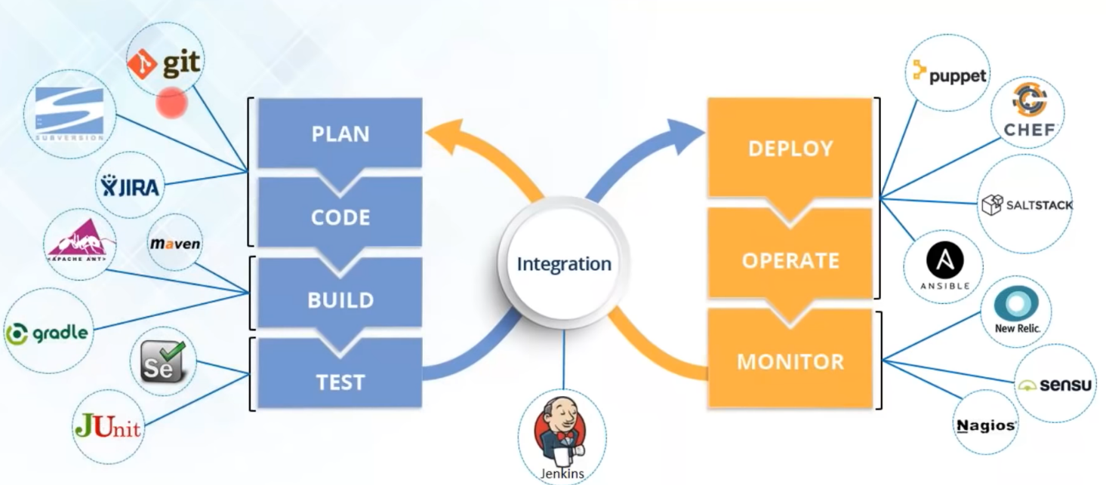
DevOps Tools

Slide 6
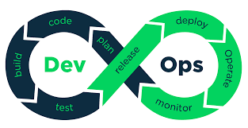
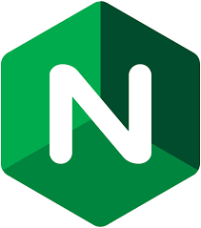



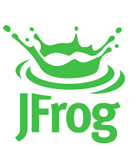
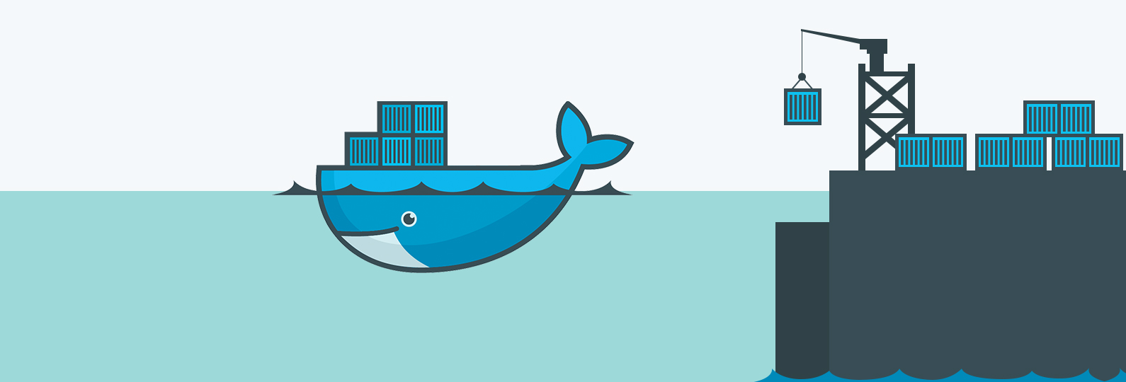
Tools We have learnt
Jenkins
NGINX
SonarQube
Tomcat
Jfrog artifactory
Docker

Slide 7

git

Slide 8
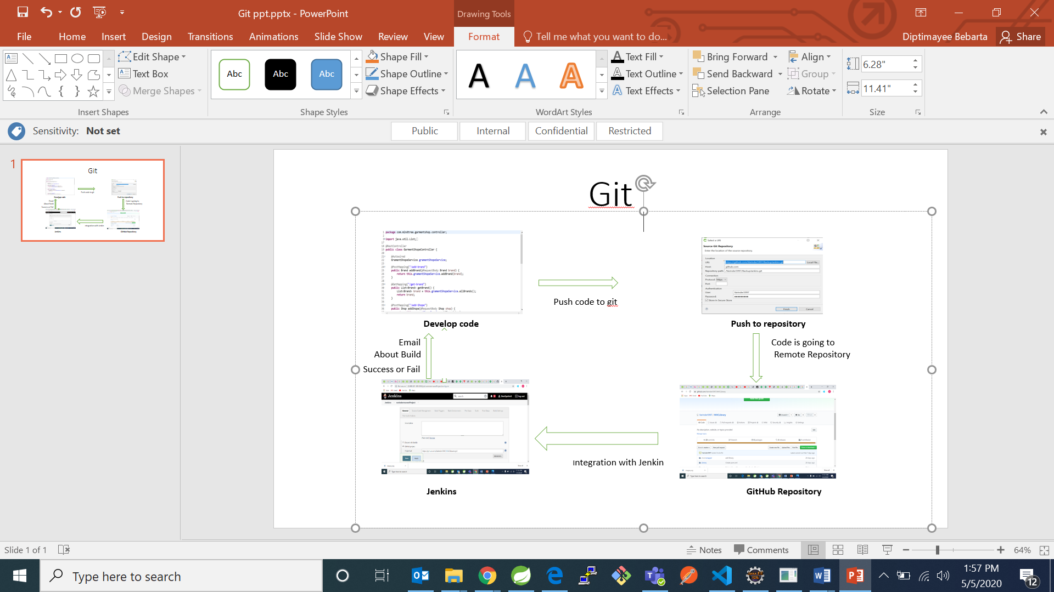

Slide 9
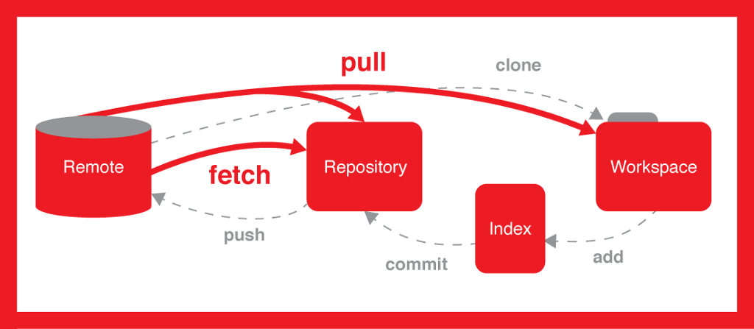
Git is a version control system (VCS) that makes it easier to track changes to files. For example, when you edit a file, git can help you determine exactly what changed, who changed it, and why.

Slide 10
Jenkins

Slide 11
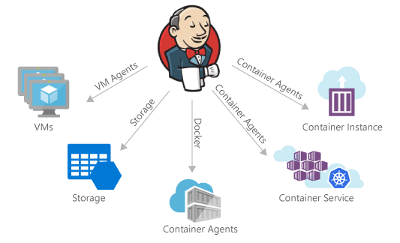
What is Jenkins?
Jenkins is automation tool written in java for continuous integration and continuous deployment which make the life of the developers easy.
Jenkins contains large number of plugins
Jenkins is a Continuous integration tools

Slide 12
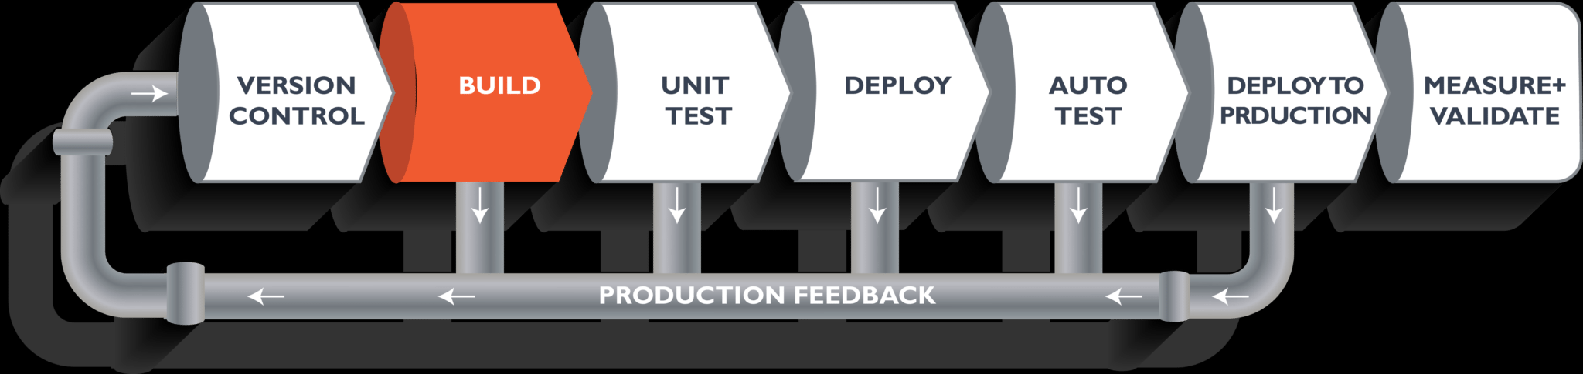
What is continuous integration tools
Continuous Integration is a process in which the developers need to commit changes to github or remote repository at regular interval of time as shown in the diagram.
After the commit made to the remote repository it is built which allows the development teams to detect the problems early and fix the error early.
Continuous Integration is the process of having shorter release cycle i.e., creating smaller features and integrating them to the source code and employing automated build and test processes for quicker feedback.

Slide 13
Work Flow of Jenkins With Git
Version Control System
(Git)
Build
(Maven)
Continuous integration
(Jenkins)

Slide 14
SonarQube
SonarQube is an automatic code review tool to detect bugs, vulnerabilities and code smells in your code. It can integrate with your existing workflow to enable continuous code inspection across your project branches and pull requests. In this sonar we can also configure quality gate
A quality gate is the best way to enforce a quality policy in any organization
you define a set of Boolean conditions on basis of which quality gate pass or fail. For example:
No new blocker issues
Code coverage on new code greater than 80%

Slide 15
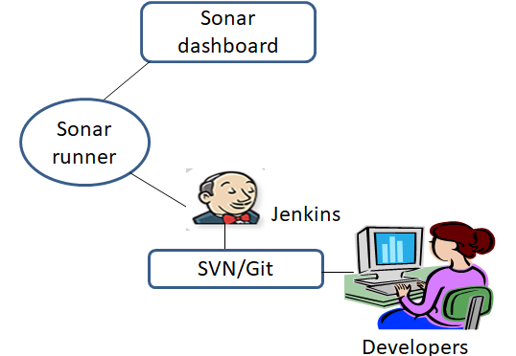
Workflow of SonarQube with Jenkins

Slide 16
Docker

Slide 17
What is Docker and Container?
What is Docker ?
Docker is a containerization platform that packages your application and all its dependencies together in the form of a docker container to ensure that your application works seamlessly in any environment.
What is Container ?
Docker Container is a standardized unit which can be created on the fly to deploy a particular application or environment. It could be an Ubuntu container, CentOs container, etc

Slide 18
Why Docker…?
Docker allows us to easily install and run software without worrying about setup or dependencies.
Developers use Docker to eliminate machine problems, i.e. "but code is worked on my laptop." when working on code together with co-workers.
Operators use Docker to run and manage apps in isolated containers for better compute density.
Enterprises use Docker to securely built agile software delivery pipelines to ship new application features faster and more securely.
Since docker is not only used for the deployment, but it is also a great platform for development, that's where we can efficiently increase our customer's satisfaction.

Slide 19
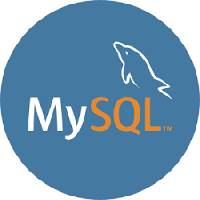
Different Types Of Docker Containers We Have Used
Jenkins
SonarQube
Jfrog artifactory
Tomcat
Nginx
MySQl

Slide 20
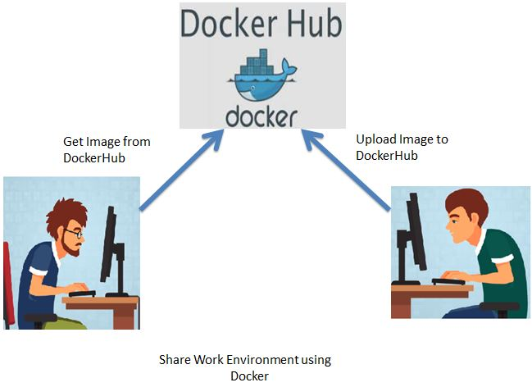
Docker Work Flow….

Slide 21
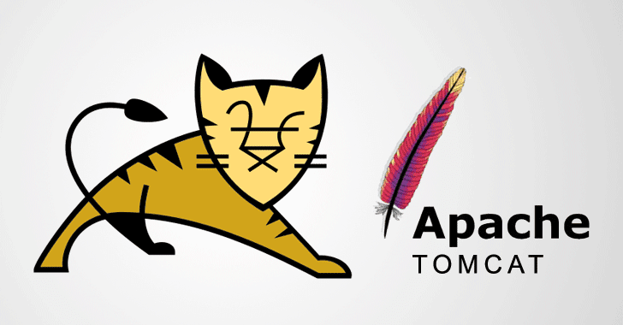

Slide 22

Tomact
Apache Tomcat is a combination of both web and application server, generally called as application server, can handle both static and dynamic pages. Of course, it needs java runtime environment as a prerequisite to run dynamic pages like servlets and jsps.
Apache is a web server, which can ideally handle static pages like HTML. To handle dynamic pages like php, we may need to load php module in apache configuration file.

Slide 23
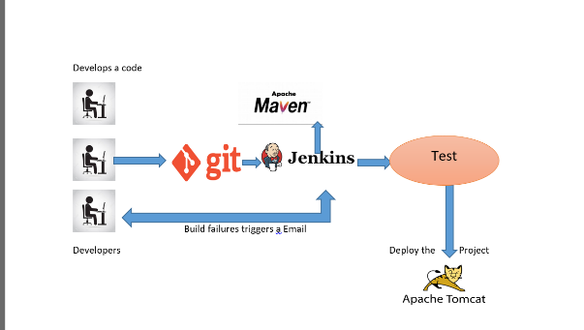
Flow chart of tomcat

Slide 24
Jfrog artifactory

Slide 25
JFrog Artifactory
JFrog artifactory which is the only universal solution which supports mostly all package managers available in the market.
It can connect with your CI environment.
JFrog artifactory is a tool designed to store the binary output of the build process for use in distribution and deployment.
artifactory provides support for a number of package formats such as Maven, Debian, NPM, Helm, Ruby, Python, and Docker
Jfrog offers high availability, replication, disaster recovery, scalability, and works with many on-prem and cloud storage offerings

Slide 26
Advantages of using Jfrog Artifactory
Artifactory is a product by Jfrog that serves as a binary repository manager. It is an artifact repository manager, which provides full supports to software created in any language or using any tool.
Continuous software delivery
Less complex problems to fix
Faster resolution of problems
Faster delivery of features
More stable operating environments
More time available to add value (rather than fix/maintain)

Slide 27
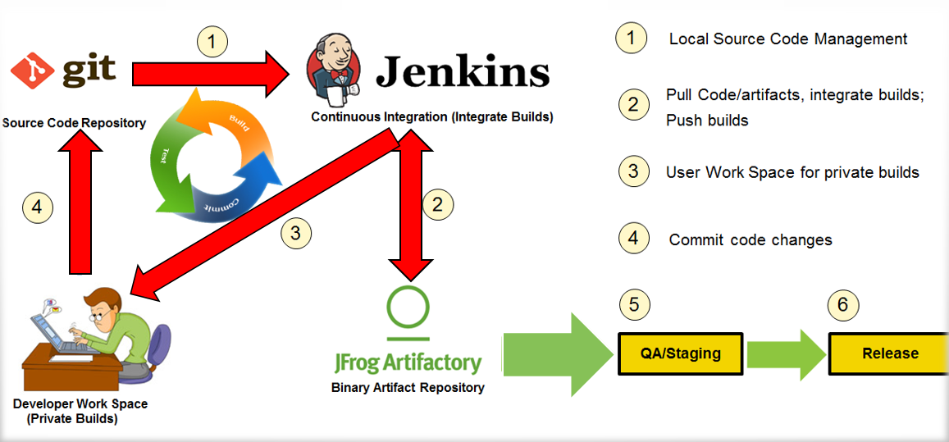
Workflow of Jfrog Artifactory with jenkins

Slide 28
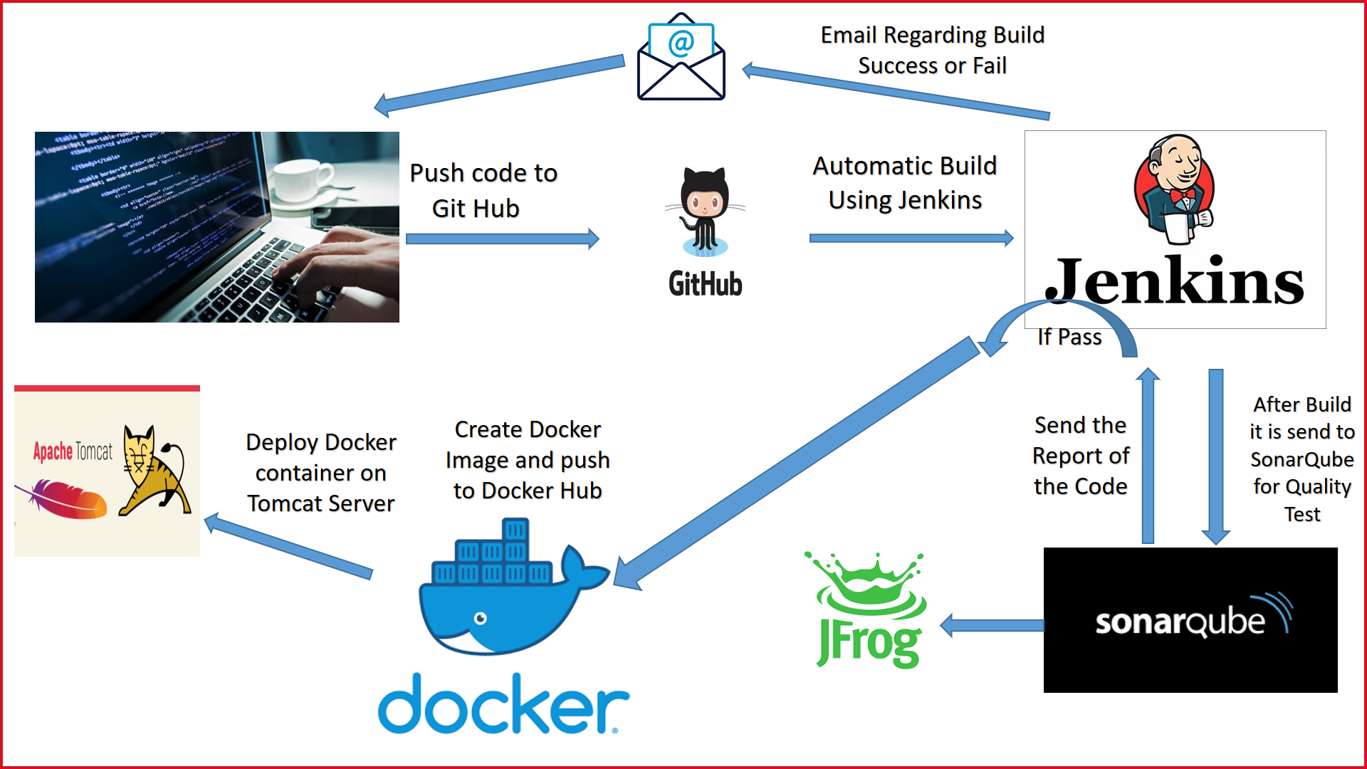
Workflow of our project

Slide 29
Thank you

